Slide 1
Best Practices For Opioid Use
Provider Webinar May 28, 2019
Chief Medical Officer Terry Welsh, M.D.
Interim Pharmacy Director Miranda Williams, Pharm.D., R.Ph.

Slide 2
Introduction
Why are there prescribing regulations AKA laws?
What are the laws for BWC and the Ohio State Medical Board (OSMB)?
What happens when you break these laws?

Slide 3
Introduction
Do these regulations actually do anything?
What is the science behind the regulations?
As a prescriber, what should I be doing? How do I do this?

Slide 4
Why Do We Have Prescribing Regulations?
Patients prescribed doses ≥90 MME, initiated with tramadol, or long acting opioids were less likely to discontinue opioids. Increasing days’ supply of the first prescription was consistently associated with a lower likelihood of opioid discontinuation. (Shah 2017)

Slide 5
Why Do We Have Prescribing Regulations?
Compared to controls, individuals with opioid use disorder (alive and deceased) had received significantly more opioid prescriptions, greater number of days’ supply, and steeper increases of opioid dosages over time. (Hser 2018)

Slide 6
Why Do We Have Prescribing Regulations?
In a study that looked at opioid prescriptions after wisdom tooth extraction, a filled perioperative opioid prescription was independently associated with persistent opioid use. (Adjusted odds ratio [OR], 2.69; 95% CI, 2.10-3.44)

Slide 7
What Are the Laws for BWC and the OSMB?

Slide 8
BWC Ohio Administrative Code 4123-6-21.7
Documentation requirements for reimbursement of opioids
> 50 MED
> 80 MED
> 120 MED
OR
> Six weeks from date of injury
>12 weeks from date of injury

Slide 9
BWC Requirements for Reimbursement >50 MED
Documented clinically meaningful improvement in function (CMIF)
Measured and meaningful improvement in ADLs or
Progress toward established goals

Slide 10
BWC Requirements for Reimbursement >50 MED
Treatment plan with clinical rationale
Risk Assessment
Screening tool
OARRS or other state monitoring system
And drug testing

Slide 11
BWC Requirements for Reimbursement >80 MED
All requirements for >50 MED and
Documented trials of alternatives to opioids

Slide 12
BWC OAC 4123-6-21.7 Utilization of opioids in the subacute or chronic phases of pain treatment for a work-related injury or occupational disease. | OSMB OAC 4731-11-14 Prescribing for subacute or chronic pain.
Treatment plan justified with clinical rationale. | Treatment plan based upon clinical information, assess at least every 3 months.
Document clinically meaningful improvement in function before continuation of opioids. | Provide rationale for continuing opioids at least every 3 months. Taper if no continued benefit.
Obtain informed consent and provide written educational material. | Obtain informed consent.
Trials of reasonable alternatives to opioid treatment. | Consider and document opioid alternatives and evaluate other treatment options every 3 months.
Opioid risk assessment with clinically validated tool. | Screen for substance use disorder or medication misuse at least every 3 months.
Drug testing | Urine drug screening based on indicators of addiction/drug abuse.
OARRS | OARRS at least every 3 months.
Consult to pain management specialist if the dose is >120 MED/day. | Consult to pain management/MTM/specialist/addiction specialist if MED >50 or MED>80. *Does not apply if on dose prior to 12/23/18** To exceed >120 MED the physician must be board certified in pain medicine/hospice/palliative care or obtain a written recommendation from one. *Doesn’t apply if on dose prior to 12/23/18*
X | Naloxone (>50 MED consider, >80 MED offer Rx).
X | Written pain agreement if >80 MED.
Consultation if there is a co-morbid substance use issue or poorly controlled mental health disorder. | X
*These requirements apply to patients on an opioid dose >50 MED unless noted otherwise.
Notes:
BEFORE PRESCRIBING OPIOIDS FOR SUBACUTE OR CHRONIC PAIN
Consider and document opioid alternatives
Assessment activities
Screening for substance misuse
Urine drug screening if evidence of substance misuse
H&P
OARRS check
Functional pain assessment
Treatment Plan
>50 MED
Update the assessment if needed
Update the treatment plan if needed
Informed consent
Consider naloxone
*The following does not apply if >50 MED prior to 12/23/18:*
Consult with pain management/specialist in the affected area/MTM/addiction specialist if aberrant behaviors are noted
>80 MED
Written pain treatment agreement
Offer Rx for naloxone
* The following does not apply if >50 MED prior to 12/23/18:*
Consult with pain management/specialist in the affected area/MTM/addiction specialist if aberrant behaviors are noted
If >50 MED the physician must complete and document every 3 months
Review treatment plan
Assessment of underlying condition
Assess adherence
Rationale for continuing opioids
The results of an OARRS check
Screening for misuse/substance disorder (UDS)
Evaluate other forms of treatment
Tapering of opioids if continued benefit not established

Slide 13
What Happens When You Break These Laws?

Slide 14
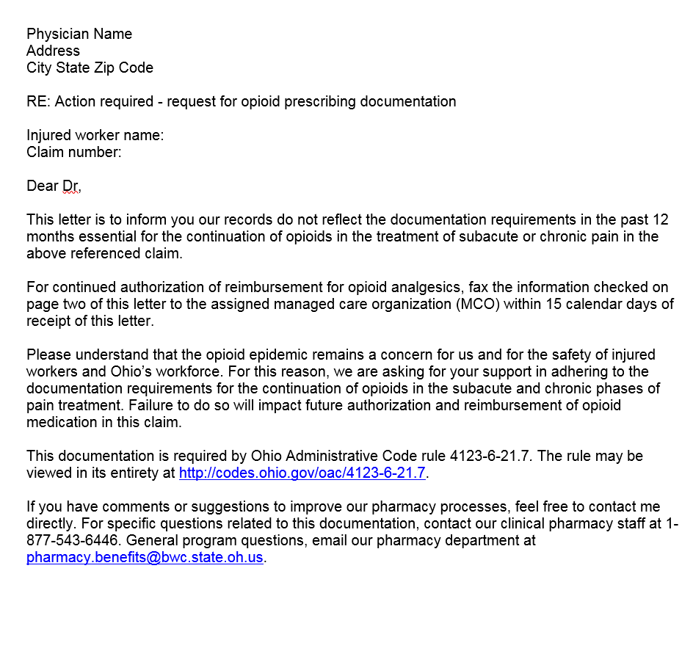
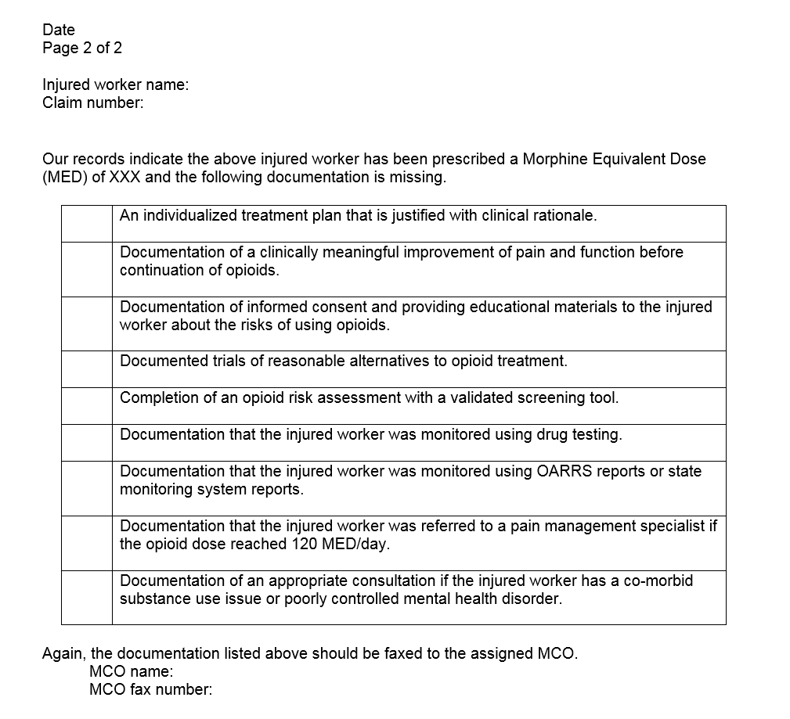
Letter to Prescriber

Slide 15
Do These Regulations Actually Do Anything?

Slide 16
Do These Regulations Actually Do Anything?
Conversation with providers about best practices
Increased provider awareness of how BWC can support them
Pain management consult
Drug tests
MAT
Non-pharmacological alternatives for pain management

Slide 17
Do These Regulations Actually Do Anything?
2014
324,473 opioid Rx’s
2018
164,761 opioid Rx’s

Slide 18
What is the Science Behind the Regulations?

Slide 19
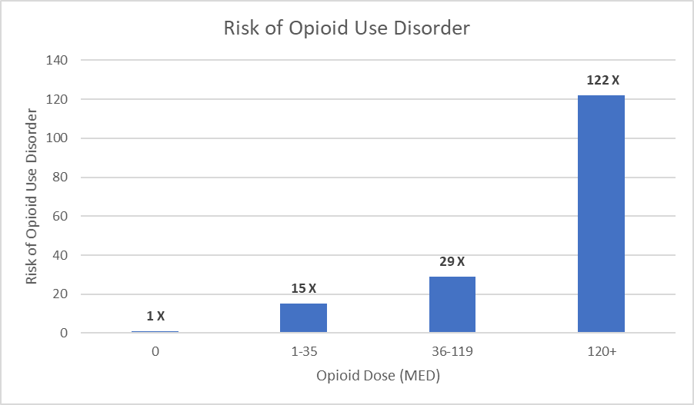
Reasons Not to Prescribe Over 120 MED
A person taking over 120 MED is 122 times more likely to develop an opioid use disorder relative to no opioid use. (Edlund 2014)

Slide 20
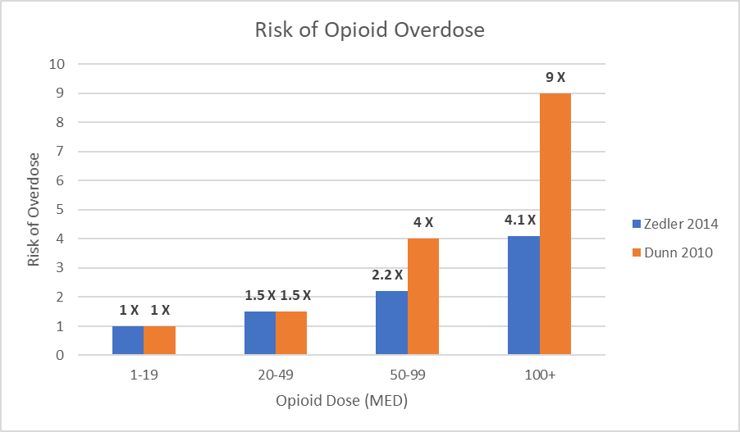
Reasons Not to Prescribe Over 120 MED
A person taking over 100 MED is 9 times more likely to overdose than a person taking less than 20 MED. (Dunn 2010)

Slide 21
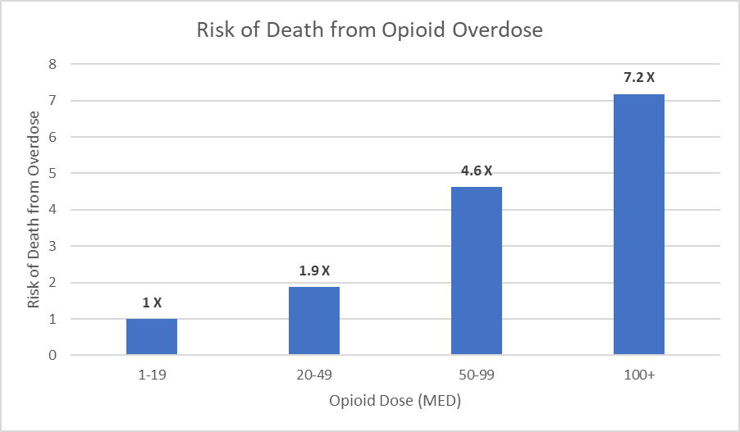
Reasons Not to Prescribe Over 120 MED
A person taking over 100 MED for chronic pain is 7.2 times more likely to die of an opioid overdose. (Bohnert 2011)

Slide 22
Dose Escalation
Dose escalation for the treatment of chronic pain resulted in no statistically significant differences for changes in pain intensity. (Morasco 2019)
Compared to patients without dose escalation (≥30 mg morphine equivalents over one year), patients with escalation had higher rates of substance use diagnoses (17% versus 1%). (Henry 2015)

Slide 23
Pain, Function and Tapering
In a study published in JAMA, treatment with opioids was not superior to treatment with nonopioid medications for improving pain-related function over 12 months for moderate to severe chronic back pain or hip or knee osteoarthritis pain. (Krebs 2018)

Slide 24
Pain, Function and Tapering
In a study looking at weaning chronic pain patients from high (>100 mg) and low doses of opioids, results showed immediate (p < 0.01) and sustained improvements in pain severity, depression, anxiety and functional impairment in both groups. (Huffman 2017)

Slide 25
As a Prescriber, What Should I Be Doing? How Do I Do This?

Slide 26
Back to the Basics
Competency
Care/Empathy
Listening

Slide 27
Reflective Listening Skills
Less likely to evoke or exacerbate patient defensiveness
Encourage patient to keep talking revealing true motives - repeat back, “Tell me more about that.”
Communicate respect, caring and compassion.

Slide 28
Reflective Listening Skills
Encourage a therapeutic alliance - “Let’s find the best solution for you.”
Open an opportunity to correct misunderstandings or clarify -“Is there anything else on your mind?” “What are your expectations?”

Slide 29
Elements of a Comprehensive Pain History
Location and character of pain
Lowest, highest and usual pain from 0-10 on a typical day
How and when the pain started
Exacerbating and relieving factors

Slide 30
Elements of a Comprehensive Pain History
Effect of pain on sleep, mood, function at work
Effect of pain on quality of personal life
What activities could the patient do before pain that they can’t do now?
What does the patient expect from medications or other treatments in analgesia or recovered function?

Slide 31
Elements of a Comprehensive Pain History
Review of past experience/exposure to opioids
Review of past medical/surgical history
Review of family medical history
Assessment of drug, alcohol and tobacco use
Psychosocial evaluation (including history of mental illness)

Slide 32
Physical Examination
TM

Slide 33
Components of an Effective Treatment Plan
Elimination of all pain is usually neither possible nor desirable.
A patient’s pain score is just one of many variables related to overall status and potential for recovery.
Treatment goals should not be set primarily in the form of changes of pain scores.

Slide 34
Components of an Effective Treatment Plan
Minor pain-score reduction may correlate with major gains in function.
Functional goals must be set collaboratively between patient and clinician, be realistic and achievable, be meaningful to the patient and be verifiable.

Slide 35
Components of an Effective Treatment Plan
Functional goals must be revisited and recalibrated at regular intervals.
Because each patient’s values and the functions they desire in life vary, each patient will have a unique set of functional treatment endpoints.

Slide 36
Components of an Effective Treatment Plan
Include as part of any treatment plan an up-front discussion of potential benefits as well as side effects, especially constipation, (addiction, and death) which are best addressed proactively.
Educate patient about the full range of issues surrounding safe use, storage and disposal of opioids.

Slide 37
Components of an Effective Treatment Plan
Explore all non-drug options first.
Explore all non-opioid options first (or second).
If you decide to initiate opioid treatment, also decide to stop opioid treatment.
Prescribing decisions (including weaning) are tied to multidimensional outcomes, many of which may be objectively demonstrated to the clinician and patient.

Slide 38
CDC Guidelines for Prescribing Opioids (Highlights)
Opioids are not the first-line or routine therapy for chronic pain.
Before starting opioids, clinicians should discuss the benefits and risks of opioid therapy.

Slide 39
CDC Guidelines for Prescribing Opioids (Highlights)
Evaluate risk factors for opioid-related harms.
Use immediate-release opioids when starting.
Start low and go slow.

Slide 40
CDC Guidelines for Prescribing Opioids (Highlights)
Check prescription drug monitoring program (PDMP) ranging from every prescription to every three months.
Use urine drug testing to identify prescribed substances and undisclosed use.

Slide 41
CDC Guidelines for Prescribing Opioids (Highlights)
Avoid concurrent benzodiazepine prescribing.
Arrange treatment for opioid use disorder if needed.

Slide 42
Documentation of Functional Goals
Functional Goal | Evidence
Begin physical therapy | Letter from physical therapist
Sleeping in bed as opposed to lounge chair | Report by family member or friend (either in-person or in writing
Participation in pain support group | Letter from group leader
Increased activities of daily living | Report by family member or friend
Walk around the block | Pedometer recordings or written log of activity
Increased social activities | Report by family member or friend
Resumed sexual relations | Report by partner
Returned to work | Pay stubs from employer or either confirming the patient is off of disability leave
Daily exercise | Gym attendance records or report from family member or friend

Slide 43
ORT (Opioid Risk Tool)
< 3 low risk
3-7 moderate risk
8 or > high risk

Slide 44
ORT (Opioid Risk Tool)
Mark each box that applies | Female | Male
Family history of substance abuse
Alcohol | 1 | 3
Illegal drugs | 2 | 3
Rx drugs | 4 | 4
Personal history of substance abuse
Alcohol | 3 | 3
Illegal drugs | 4 | 4
Rx drugs | 5 | 5
Age between 16-45 years | 1 | 1
History of preadolescent sexual abuse | 3 | 0
Psychological disease
ADD, OCD, bipolar, schizophrenia | 2 | 2
Depression | 1 | 1
Scoring Totals

Slide 45
Questions
Pharmacy.benefits@bwc.state.oh.us

